Slide 1

Medicare Reimbursement and Connected Health: Where Are We?
Session #169, February 13, 2019
Brian Scarpelli, Senior Global Policy Counsel, Connected Health Initiative

Slide 2
Conflict of Interest
Brian Scarpelli, Senior Global Policy Counsel of ACT | The App Association’s Connected Health Initiative, has no real or apparent conflicts of interest to report.

Slide 3
Agenda
About the Connected Health Initiative (CHI)
Physician Fee Schedule (PFS)
Quality Payment Program (QPP)
Home Health Prospective Payment System (HHPPS)
Discussion/Questions

Slide 4
Learning Objectives
Identify the discrete ways in which the use of connected health tech improves patient outcomes while reducing costs
Explain the state of play regarding reimbursement for use of connected health tools in Medicare and understand its impact on the broader healthcare ecosystem
Identify challenges and opportunities to the uptake of connected health tools in Medicare
Explain how these challenges and opportunities to the uptake of connected health tools affect your organization and what actions you can take accordingly

Slide 5
About CHI
The CHI is a not-for-profit multistakeholder consensus advocacy effort to advance uptake of digital health tools widely
Intersection of medical/health industry and technology innovators
Advocate before Capitol Hill, US agencies, European Commission, etc.
Active in key private-sector initiatives (AMA Digital Medicine Payment Advisory Group, Xcertia, etc).

Slide 6



About CHI

Slide 7
Growing Needs (and Costs)
133 million+ Americans suffer from chronic conditions such as diabetes, chronic obstructive pulmonary disease, and mental illness (~171 million by 2030)
U.S. healthcare spending to reach 20% of the entire U.S. economy 2025

Slide 8
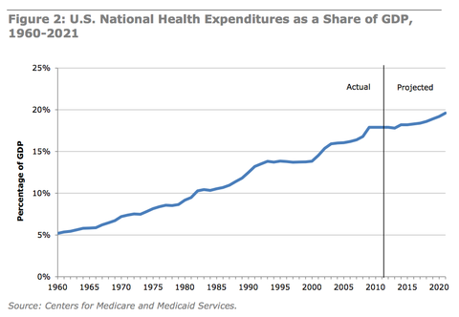
Growing Needs (and Costs)

Slide 9
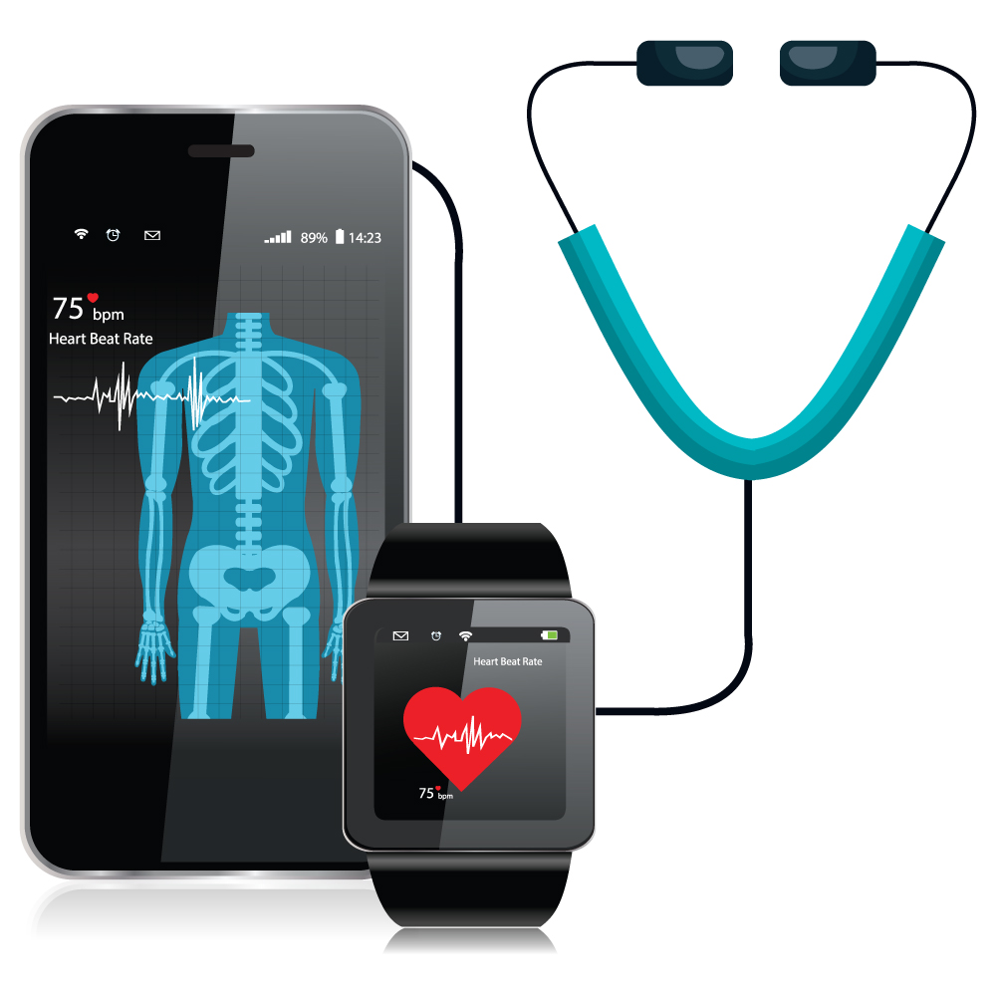
Connected Health Tech in 21st Century Healthcare Systems
Strong (and growing) body of evidence shows that connected health tech [see https://bit.ly/2MblRou]:
  Improves patient care
  Reduces hospitalizations
  Helps avoid complications
  Improves patient engagement
  Reduces healthcare costs
Driving Internet of Things marketplace (valued at over $250b in the U.S. alone)
Job creation

Slide 10

Medicare Reimbursement – Background and Status Quo
“Telehealth” vs. “Store-and-forward”
1834(m) & the historical treatment of “Medicare Telehealth Services”
  Telehealth Services List
Historical treatment of remote monitoring
  Remote monitoring is not telehealth subject to 1834(m) restrictions
Legislative efforts to address:
  CONNECT for Health Act
  Bipartisan Budget Act (Medicare Telestroke, ESRD, MA, ACOs) [PASSED]
  SUPPORT for Patient and Communities Act

Slide 11
CY2019 PFS & Digital Health
HCPCS code G2012 – Brief communication technology-based service (e.g. virtual check-in).
HCPCS code G2010 – Remote evaluation of pre-recorded patient information.
CPT codes 99453, 99454, and 99457 – Chronic care remote physiologic monitoring.
CPT codes 99446, 99447, 99449, 99451, 99452 – Interprofessional internet consultation.
Updates to Medicare Telehealth Services List

Slide 12
CY2019 PFS: HCPCS G2012
“Brief communication technology-based service, e.g. virtual check-in, by a physician or other qualified health care professional who can report evaluation and management services, provided to an established patient, not originating from a related E/M service provided within the previous 7 days nor leading to an E/M service or procedure within the next 24 hours or soonest available appointment; 5-10 minutes of medical discussion.”

Slide 13
CY2019 PFS: HCPCS G2012
Performed by a physician or other qualified health care professional who can report E/M services
  Must be established patient
  Allows:
    Audio-only real-time telephone interactions
    Two-way audio interactions enhanced with video or other kinds of data transmission
  Not originating from a related E/M service provided within previous 7 days
  Not leading to an E/M service or procedure within the next 24 hours or soonest available appointment
  5-10 minutes of medical discussion
  No frequency limitations
Work RVU of 0.25, based on a direct crosswalk to CPT code 99441

Slide 14
CY2019 PFS: HCPCS G2010
“Remote evaluation of recorded video and/or images submitted by an established patient (e.g., store and forward), including interpretation with follow-up with the patient within 24 business hours, not originating from a related E/M service provided within the previous 7 days nor leading to an E/M service or procedure within the next 24 hours or soonest available appointment”

Slide 15
CY2019 PFS: HCPCS G2010
Remote evaluation of pre-recorded patient information
  Information = recorded video and/or images submitted by patient
    Used to determine if a visit or service is needed
  Must be established patient
  Not originating from a related E/M service provided within previous 7 days
  Not leading to an E/M service or procedure within the next 24 hours or soonest available appointment
  Includes interpretation with follow-up within 24 business hours
    Via phone call, audio/video communication, secure text message, email, or patient portal communication
Valuation as proposed with an WRVU of 0.18

Slide 16
CY2019 PFS: CPT 99453, 99454, and 99457
Remote monitoring of physiologic parameter(s) (e.g. Weight, blood pressure, pulse oximetry, respiratory flow rate)
  CPT 99453 - Initial; set-up and patient education on use of equipment
  CPT 99454 - initial; device(s) supply with daily recording(s) or programmed alert(s) transmission, each 30 days
  CPT 99457 - treatment management services (WRVU of 0.61)
    20 minutes or more of clinical staff/physician/other qualified healthcare professional time in a calendar month requiring interactive communication with the patient/caregiver during the month
CMS will provide additional guidance regarding what types of technology are covered under these codes

Slide 17

CY2019 PFS: CPT 99453, 99454, and 99457

Slide 18
CY2019 PFS: CPT 99453, 99454, and 99457
Payment Code | Description | Payment $ (est) | Effective Date
99091 | Collection, interpretation of physiologic data, 30 minutes or more per month by physician or other qualified healthcare professional (QHP) (professional component) | $59 | Jan 1, 2018
99453 | Initial set-up of technology and patient education (technical component) | $21 | Jan 1, 2019
99454 | Device supply with daily recordings, programmed alerts transmission, monthly (technical component) | $69 | Jan 1, 2019
99457 | Collection, interpretation of physiologic data, 20 minutes or more per month requiring interactive communication with patient by physician, QHPs, and other clinical staff (professional component) | $54 | Jan 1, 2019

Slide 19
CY2019 PFS: CPT 99446, 99447, 99449, 99451, 99452
Interprofessional internet consultation (telephone/internet assessment and management service)
  CPT 99446 - 5-10 minutes of medical consultative discussion and review (WRVU 0.35)
  CPT 99447 - 11-20 minutes of medical consultative discussion and review (WRVU 0.70)
  CPT 99448 - 21-30 minutes of medical consultative discussion and review (WRVU 1.05)
  CPT 99449 - 31 minutes or more of medical consultative discussion and review (WRVU 1.40)
Includes a verbal and written report to the patient's treating/requesting physician or other qualified health care professional
Billing limited to practitioners that can independently bill Medicare for E/M services

Slide 20
CY2019 PFS: CPT 99446, 99447, 99449, 99451, 99452
Interprofessional internet consultation (telephone/internet/electronic health record)
  CPT 99451 - Assessment and management service provided by a consultative physician (WRVU 0.70)
    5 or more minutes of medical consultative time
  CPT 99452 - Referral service(s) provided by a treating/requesting physician or qualified health care professional (WRVU 0.70)
    30 minutes
Includes a verbal and written report to the patient's treating/requesting physician or other qualified health care professional
Billing limited to practitioners that can independently bill Medicare for E/M services

Slide 21
CY2019 PFS: Medicare Telehealth Services List
Medicare Telehealth Services list:
  Diagnosis, treatment, or evaluation of acute strokes
  Treatment of substance abuse or co-occurring mental health disorders
  Clinical assessment for monthly end state renal disease (ESRD)

Slide 22
CY2019 PFS: Acute Stroke Treatment
Removes originating site restrictions
  Services may be furnished in any hospital, critical access hospital, or mobile stroke unit, or any other site determined appropriate by HHS
  Mobile stroke unit provides services to diagnose, evaluate, and/or treat acute stroke symptoms

Slide 23
CY2019 PFS: Substance Abuse Treatment
Removes geographic requirements for telehealth services furnished on or after 7/1/2019
  Individual’s home now a permissible originating site
    No originating site fee required in this case
Practitioner responsible for diagnosis and determining whether telehealth treatment is clinically appropriate
CMS will provide additional subregulatory guidance

Slide 24
CY2019 PFS: ESRD
Removes geographic requirements
  Individual’s home now a permissible originating site
ESRD patients receiving home dialysis may choose to receive monthly telehealth clinical assessments on or after 1/1/2019
  Must receive a non-telehealth face-to-face visit on a monthly basis during first three months of home dialysis and at least once every 3 consecutive months thereafter

Slide 25
Quality Payment Program
Until 2015, payment increases for Medicare services were set by the Sustainable Growth Rate (SGR) law which capped spending increases according to the growth in the Medicare population. SGR had to be passed by Congress annually.
Medicare Access and CHIP Reauthorization Act of 2015 (MACRA) repealed SGR and created the Quality Payment Program (QPP) to “reward high value, high quality Medicare clinicians with payment increases - while at the same time reducing payments to those clinicians who aren’t meeting performance standards.”

Slide 26
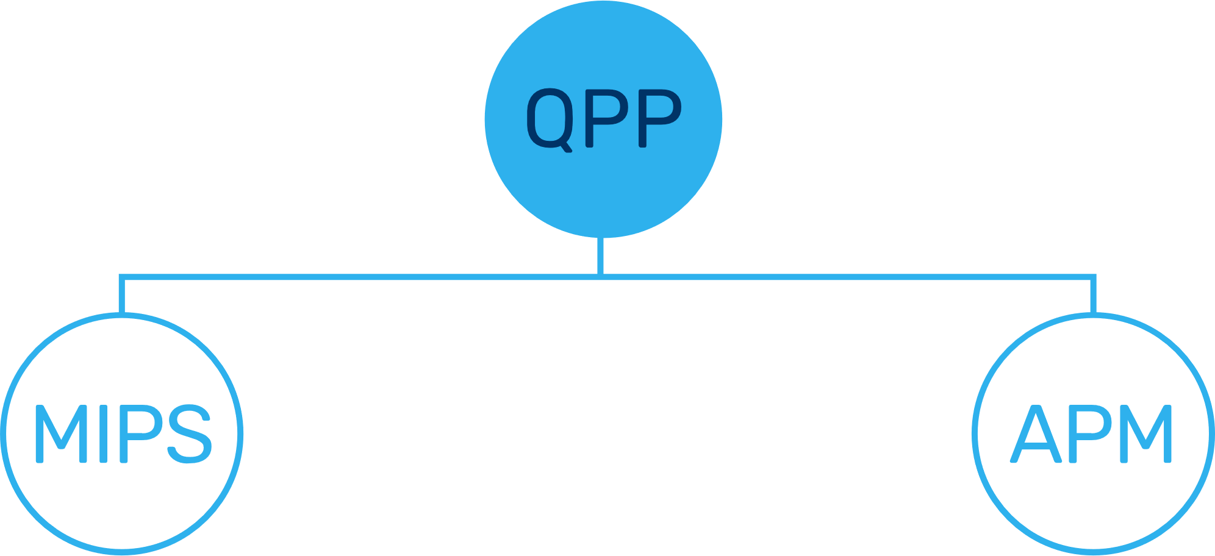
Quality Payment Program
Clinicians have two tracks to choose from in the Quality Payment Program based on their practice size, specialty, location, or patient population:
  Merit-based Incentive Payment System (MIPS)
  Advanced Alternative Payment Models
QPP started on January 1, 2017.
More information: https://qpp.cms.gov/

Slide 27
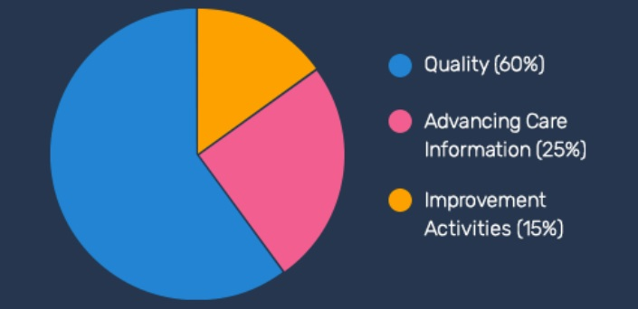
Quality Payment Program
Merit-based Incentive Payment System (MIPS)
Performance measured through the data clinicians report:
  Quality
  Improvement Activities
  Promoting Interoperability
  (formerly Advancing Care
  Information)
MIPS designed to update and consolidate previous programs, including: Medicare Electronic Health Records (EHR) Incentive Program for Eligible Clinicians, Physician Quality Reporting System (PQRS), and the Value-Based Payment Modifier (VBM).

Slide 28
Quality Payment Program
Improvement Activities (IA) notables:
  “Engage Patients and Families (using PGHD) to Guide Improvement in the System of Care” is classified as a "high-weighted" activity
  “Use of CEHRT to Capture Patient Reported Outcomes” remains a "medium-weighted" activity
Advancing Care Information (ACI) Performance Category
  10% Bonus for using CEHRT to complete at least one IA

Slide 29
Quality Payment Program
Activity ID, Title: IA_BE_14, Engage Patients and Families to Guide Improvement in the System of Care
Subcategory: Beneficiary Engagement
Weighting: High
Eligibility for Advancing Care Information Bonus: Yes
Full Activity Description: Engage patients and families to guide improvement in the system of care by leveraging digital tools for ongoing guidance and assessments outside the encounter, including the collection and use of patient data for return-to-work and patient quality of life improvement. Platforms and devices that collect [PGHD] must do so with an active feedback loop, either providing PGHD in real or near-real time to the care team, or generating clinically endorsed real or near-real time automated feedback to the patient, including patient reported outcomes (PROs). Examples include patient engagement and outcomes tracking platforms, cellular or web-enabled bi-directional systems, and other devices that transmit clinically valid objective and subjective data back to care teams. Because many consumer-grade devices capture PGHD (for example, wellness devices), platforms or devices eligible for this improvement activity must be, at a minimum, endorsed and offered clinically by care teams to patients to automatically send ongoing guidance (one way). Platforms and devices that additionally collect PGHD must do so with an active feedback loop, either providing PGHD in real or near-real time to the care team, or generating clinically endorsed real or near-real time automated feedback to the patient (e.g. automated patient-facing instructions based on glucometer readings). Therefore, unlike passive platforms or devices that may collect but do not transmit PGHD in real or near-real time to clinical care teams, active devices and platforms can inform the patient or the clinical care team in a timely manner of important parameters regarding a patient’s status, adherence, comprehension, and indicators of clinical concern.

Slide 30
Quality Payment Program
An Alternative Payment Model (APM) is a payment approach that gives added incentive payments to provide high-quality and cost-efficient care
  Approved by both the Physician-Focused Payment Model Technical Advisory Committee (PTAC) & HHS.
  APMs can apply to a specific clinical condition, a care episode, or a population.
Remaining challenges:
  Rule text on Alternative Payment Models (APMs) still omits discussion of telehealth/remote monitoring
  Lack of development of QPP APMs through PTAC & HHS

Slide 31
Home Health Prospective Payment System & RPM
Home health agencies (HHAs) are public, nonprofit or proprietary agencies that provide skilled nursing services and at least one of the following other therapeutic services: physical therapy, speech language pathology, or occupational therapy, medical social services, or home health aide services in a place of residence used as a patient’s home.
The HHPPS provides HHAs with payment under a retrospective reimbursement system for all Medicare-covered home health services furnished under a plan of care (POC) paid on a reasonable cost basis.
In 2016, about 3.4 million Medicare beneficiaries received care, and the program spent about $18.1 billion on home health care services.

Slide 32
Home Health Prospective Payment System & RPM
HHPPS rule CMS has amended 42 CFR 409.46 (HHA allowable administrative costs) to include the costs of remote patient monitoring as an allowable HHA operating expense if remote patient monitoring is used by the HHA to augment the care planning process.
§409.46 Allowable administrative costs.
(e) Remote patient monitoring. Remote patient monitoring is defined as the collection of physiologic data (for example, ECG, blood pressure, or glucose monitoring) digitally stored and transmitted by the patient or caregiver or both to the home health agency. If remote patient monitoring is used by the home health agency to augment the care planning process, the costs of the equipment, set-up, and service related to this system are allowable only as administrative costs. Visits to a beneficiary's home for the sole purpose of supplying, connecting, or training the patient on the remote patient monitoring equipment, without the provision of a skilled service are not separately bill.

Slide 33

2020 and beyond

Slide 34
Questions
Contact:
Brian Scarpelli
Senior Global Policy Counsel
517-507-1446 | bscarpelli@actonline.org
Connected Health Initiative (www.connectedhi.com)
@brianscarpelli
https://www.linkedin.com/in/brianscarpelli/
Please complete online session evaluation!

